Slide 1

Analyzing Social Sentiment Data to Determine Correlation with Cryptocurrency Price
Ripa Shah | MS in Data Science
Karthikeyan Manickam, Martin Leisin | MS in AI for Business
University of Arizona

Slide 2
Research Overview
The Challenge
Our Approach
We collected 12 months of historical and live Reddit sentiment data for five major cryptocurrencies (Bitcoin, Ethereum, Solana, Dogecoin, and Cardano), cross-referenced with Yahoo Finance price data. Module 2 analysis leveraged Azure Cosmos DB for scalable storage and PySpark for distributed data processing.
Module 1 analysis focuses on Solana and leverages the Apify API for data collection and to create a web-based solution. differentiates from past research by analyzing data from Apify API versus using data directly from the Reddit API
Emotional posts on social media platforms like Reddit and Twitter can significantly affect crypto investor behavior and price volatility. This research explores whether cryptocurrency prices can be predicted using user sentiment analysis.
Three Algorithms
Five Cryptocurrencies
12 Months
Random Forest, LSTM, and SVM
BTC, ETH, SOL, DOGE, ADA
Historical & live data collection

Slide 3
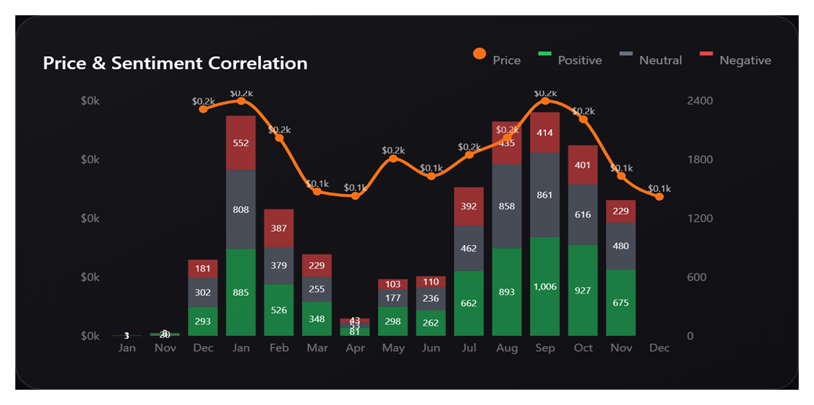
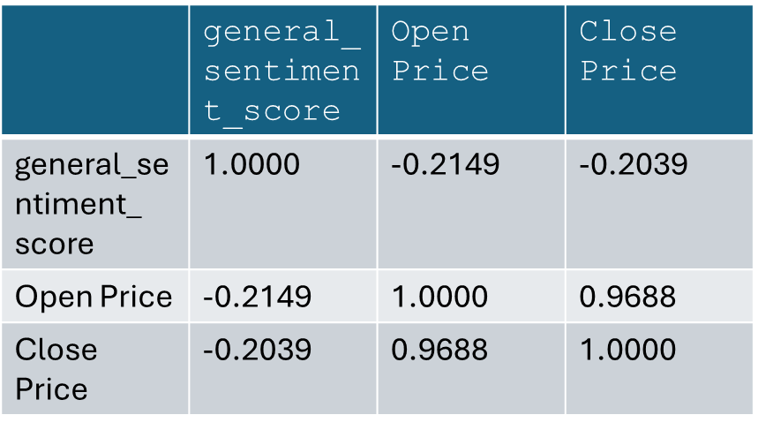
Module 1: Data Collection & Processing
Data Imports
Price Aggregation
Data gathered from Reddit using Apify API and price data gathered directly from Binance with Python code.
Price aggregated by date for each cryptocurrency to analyze sentiment-to-price correlation. Data further aggregated by month for detailed trend analysis.
Sentiment Analysis
Sentiment analyzed from raw data, then with VADER sentiment analysis, hyperparameterized, and cleansed for analysis and modeling.

Slide 4
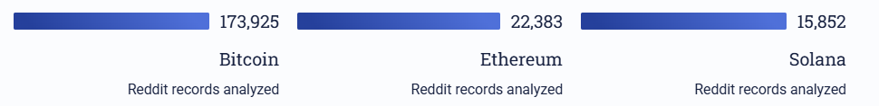
Module 1: Key Discoveries
Volume Impact
Sentiment Patterns
There is a direct correlation between the volume of sentiment data and cryptocurrency price. The two largest months of negative sentiment data correlated to immediate drops in price in the following month for Solana.
The months with the largest negative sentiment correlated to drops in price, and the months with the most positive sentiment also correlated to increase in price. Therefore, volume of data was proven to be a predictor of price drops and increases.
When there is a large volume of sentiment data, the price drops in subsequent months. When there is a low volume of data, the price increases in subsequent months.
As volume of sentiment data decreased, generally the price of the cryptocurrency decreased.

Slide 5
Module 1: Data Collection Challenges
Data collection presented unique obstacles, necessitating innovative solutions to ensure the robustness and breadth of our sentiment analysis.
Big Data Technology & APIs
Access to Apify API
We successfully leveraged the Apify API to gather sentiment data from relevant cryptocurrency communities on Reddit, ensuring continuous data flow. Using Apify API required continuous payment
To meet the demands of Big Data technology and dynamic reporting, we needed robust APIs for real-time data access and processing.
Solution: Custom APIs were developed in Python using Grok and Flask, complete with secure tunneling and authentication. This facilitated dynamic dashboard reporting via a web front-end built with React, allowing functions like Pearson correlation to be called directly.

Slide 6

MODULE 2
Advanced Machine Learning Analysis
Using Reddit API and Yahoo Finance Prices, we collected sentiment data and price data and stored those records into Azure CosmosDB database by implementing a Python script. Once we had 12 months of historical and live data, we converted those records from Azure CosmosDB to PySpark. By using three main machine learning algorithms, we trained sentiment scores to forecast crypto prices for next 3 months.

Slide 7
Module 2: Research Objectives
Optimal Forecasting Algorithm
Sentiment Relationship
Identify the optimal forecasting algorithm for Bitcoin and Ethereum price movements using advanced machine learning techniques.
Investigate the complex relationship between sentiment (current, previous-day, and next-day) and cryptocurrency prices to determine the influence of lagged and future public mood.
Storage Solutions
Data Quality Impact
Provide comparative analysis of data storage solutions, assessing the benefits of Azure Cosmos DB over traditional CSV file storage.
Analyze the impact of rigorous data cleaning and exploratory analysis methodologies on overall performance and accuracy of forecasting algorithms.

Slide 8

Azure Cosmos DB: Why It Matters
Global Distribution
NoSQL has multi-region write capabilities and automatic geo-replication, allowing applications to serve customers worldwide with low latency. CSV files are limited to specified storage places.
Automatic Indexing
NoSQL automatically indexes data, which improves query performance. Indexing CSV files must be done manually or using external tools, which can be hard and inefficient.

Slide 9
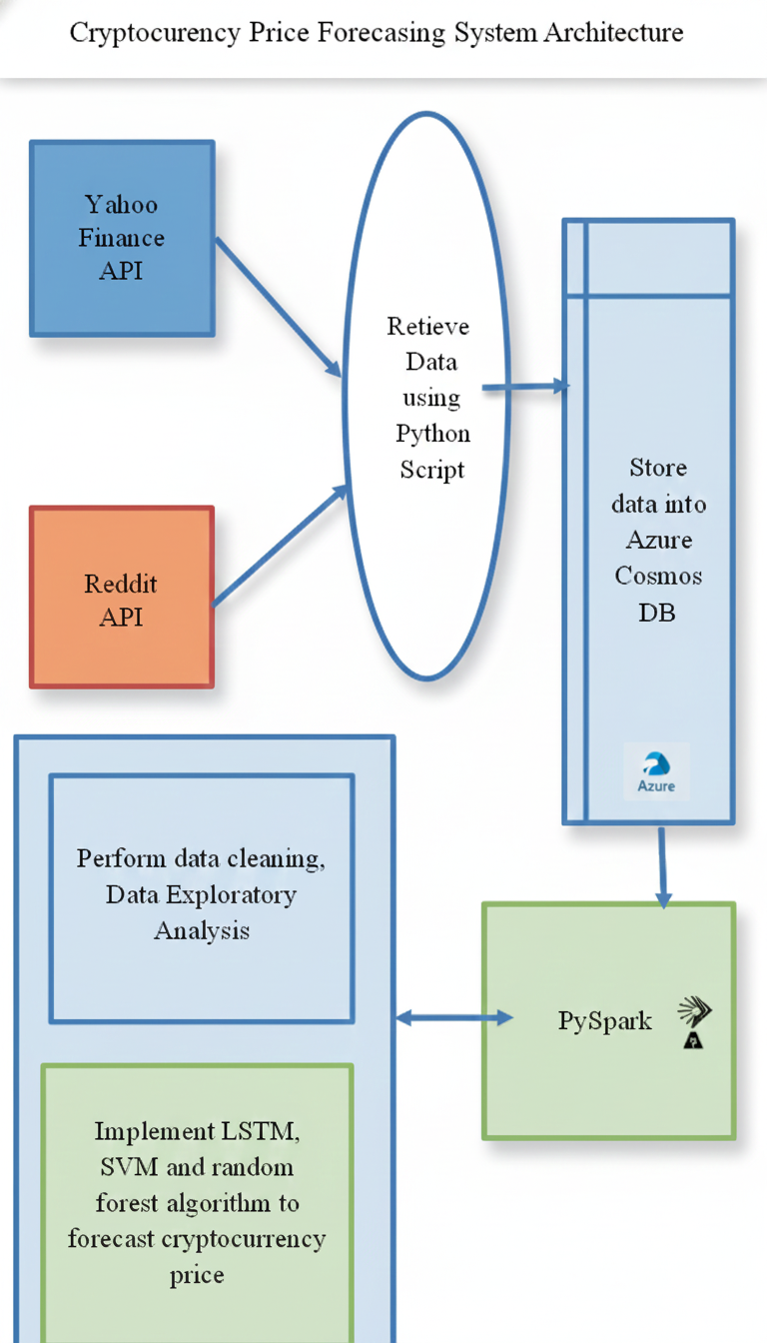




Project Architecture
Reddit API
Sentiment data collection with VADER analysis
Yahoo Finance
Cryptocurrency price data retrieval
Azure Cosmos DB
Scalable NoSQL storage
PySpark
Distributed data processing
Data collected every four hours for both historical and live analysis. Total dataset: 22,548 Reddit sentiment records and 11,692 crypto price records spanning 12 months.

Slide 10
Data Preprocessing & Cleaning
Schema Assignment
Data Cleaning Process
Assigned schemas to datasets retrieved from Azure CosmosDB.
Removed duplicate values (22,548 to 22,506 records)
Implemented mean imputation for sentiment_score field
Filled missing string values with "missing" keyword
Feature Engineering
Verified no null values in critical date field
Removed inessential cryptocurrency values
Applied filter transformation on sentiment score to classify data as neutral, positive, or negative
Renamed 'timestamp' to 'date' in Crypto-Price dataset to facilitate seamless join with Reddit-Sentiment dataset.
Retrieve only cryptocurrency abbreviation from ‘symbol’ field in Crypto-Price dataset and renamed it to ‘cryptocurrency’ field and removed ‘symbol’ field.

Slide 11

Exploratory Data Analysis: Key Insights
5
22K
12
Cryptocurrencies
Sentiment Records
Months
BTC, ETH, ADA, SOL, DOGE analyzed
Total Reddit posts and comments
Data collection period
Distribution analysis revealed highest number of positive sentiments overall. SOL had most negative reviews, while ETH and DOGE had most positive reviews. Dataset contains mildly negative, neutral, and positive sentiment ranging from -0.5 to 0.25.

Slide 12
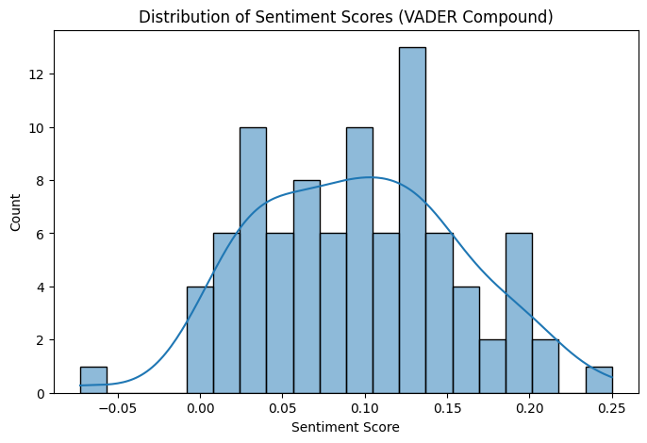
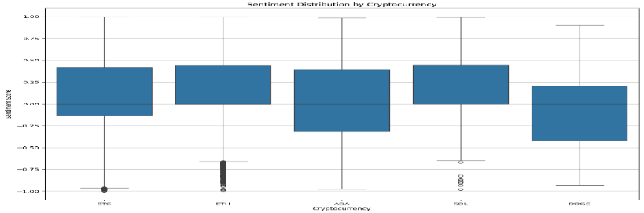
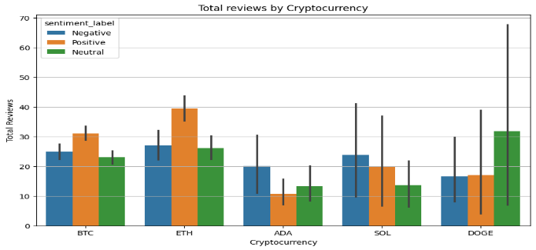
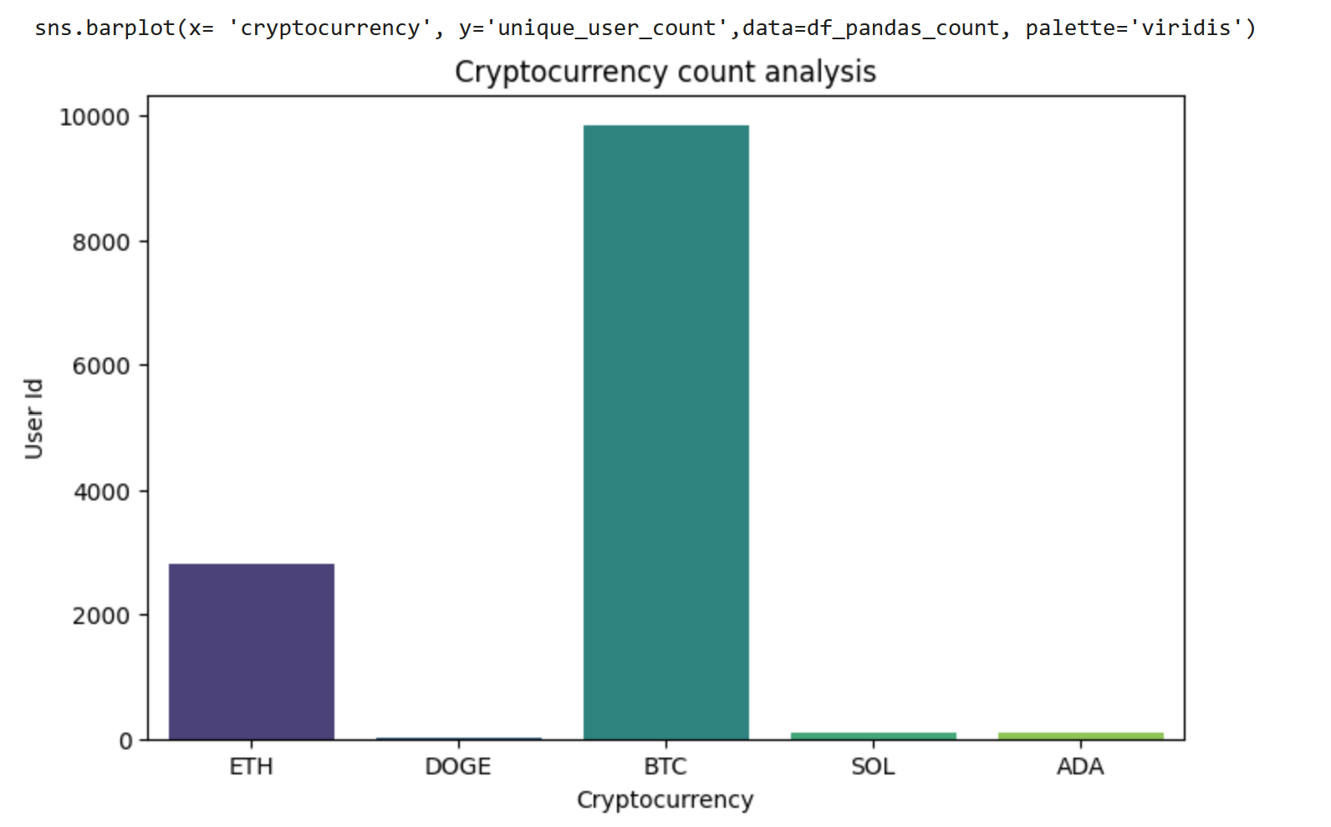
Exploratory Data Analysis: Key Insights
Distribution Analysis
Sentiment Distribution By Cryptocurrency
Total reviews by Cryptocurrency
Cryptocurrency Count Analysis

Slide 13
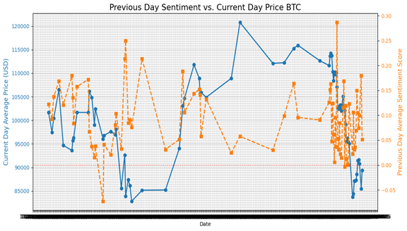
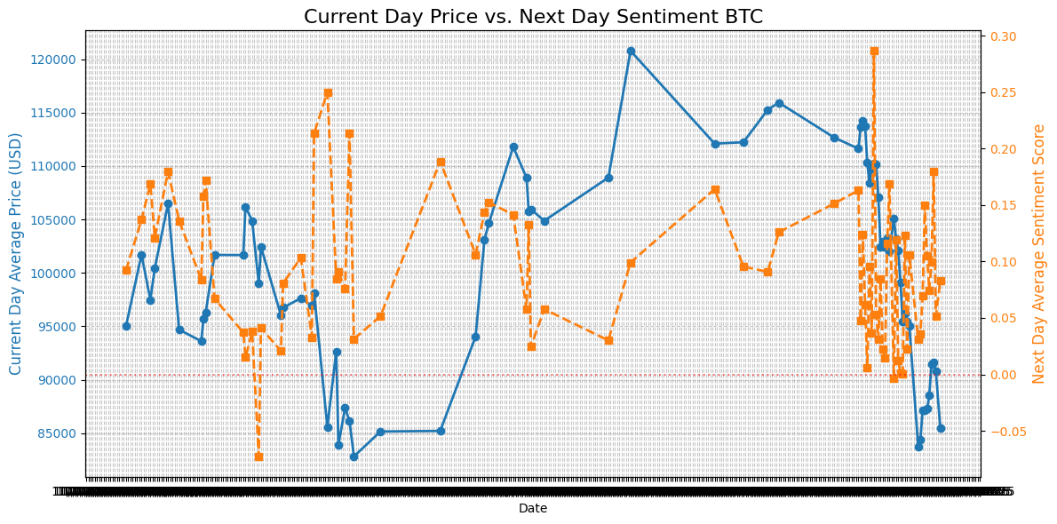
Time Series Analysis: Sentiment vs. Price
Key Findings
Previous Day Sentiment: Lagged sentiment (previous day's sentiment) exhibits a stronger correlation with cryptocurrency price fluctuations compared to concurrent (current day) sentiment.
Next Day Sentiment: Next day's sentiment also exhibits correlation with cryptocurrency price, though the relationship is less direct.
Current Day: No immediate, strong, and consistent visual correlation where sharp drops in sentiment directly precede sharp drops in price.
Analysis period: November 1, 2024 to December 4, 2025. The sentiment line often leads or moves independently of the price line, reinforcing the need for rigorous correlation analysis using lagged sentiment.

Slide 14
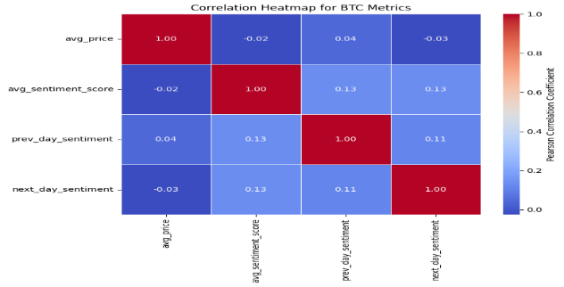
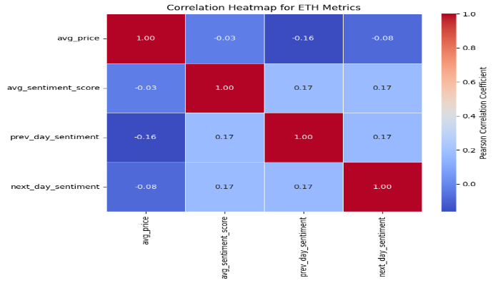
Correlation Coefficient
The correlation coefficient measures the strength and direction of a linear relationship between two variables, which is useful in assessing investment risks and optimizing portfolios.

Slide 15
Machine Learning Model Performance
Random Forest
LSTM (Deep Learning)
SVM
BTC: 51.0% average accuracy across folds
BTC: 67.6% Overall accuracy
BTC: 67.6% Overall accuracy
ETH: 64% average accuracy
ETH: 66.4% Overall accuracy
ETH: 70% Overall accuracy
Timeseries split ensured representative sampling
Moderate to superior performance for sequential data patterns
Comparable performance to LSTM with different approach
Data scaling using MinMax scaler significantly improved model performance. LSTM and SVM models achieved the highest accuracy rates for price direction prediction. TimeseriesSplit is a variation of k-fold technique which is utilized for balanced sampling in Random Forest algorithm. timeSeriesSplit is a cross-validation technique that respects the order of time, always using older data for training and newer data for testing. This accurately simulates real-world forecasting where you predict future outcomes based on the past.

Slide 16
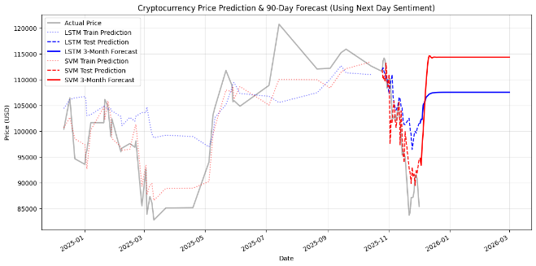
BTC Forecast for 3 month Price for LSTM and SVM:

Slide 17
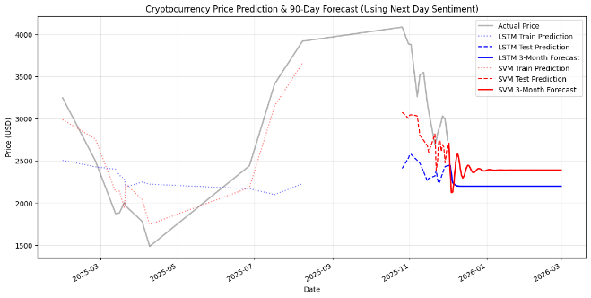
ETH Forecast for 3 month Price for LSTM and SVM:

Slide 18

Conclusions & Future Directions
Key Takeaways
Challenges Overcome
Volume of sentiment data is a strong predictor of cryptocurrency price movements
Migrated from CSV to Azure Cosmos DB (10+ hours troubleshooting)
Resolved Google Colab dynamic IP networking issues
Previous day sentiment shows stronger correlation than current day sentiment
Learned PySpark from scratch, overcoming Pandas syntax defaults
Implemented timeseries split to fix random sampling and stratified K-fold failures
LSTM and SVM models achieved 70% accuracy for Bitcoin price direction
Optimized scalers and date splits to achieve 70% accuracy
Azure Cosmos DB provides superior scalability and performance over CSV storage
Rigorous data cleaning and preprocessing are critical for model accuracy
Acknowledgment: Special thanks to Professor Seokjun Youn for guidance and feedback throughout this project.

